Slide 1
9.3 Feature Scaling via Standard Normalization

Slide 2
In this Section and the following Section we two fundamental methods of input normalization - also called feature scaling.
While this sort of feature engineering step provides several benefits to the learning process that we will see throughout this Chapter, here we focus on how it substantially improves learning speed when using first order optimization algorithms.

Slide 3
As such this 'optimization trick' proves quite useful in our current context of linear machine learning, and will prove especially valuable when we deal with nonlinear learning in the future - like e.g., deep networks - where training via first order methods is all but essential.
In this Section we first explore the benefit of our first feature scaling technique: standard normalization. We do this by exploring a number of simple supervised learning examples.

Slide 4
Standard normalization of classification data

Slide 5
Below we load in a simple two class dataset with N=1 input feature.
A quick glance at the data and we can intuit that - if tuned properly - a two class linear classifier will perform very well on this dataset...
...as the data appears to be largely separable by a zero-dimensional line (i.e., a point).

Slide 6
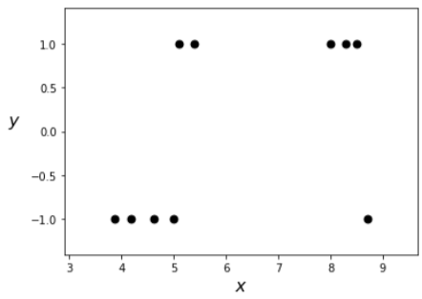

Slide 7
Since we only need properly tune two parameters in learning a linear classifier for this dataset, we can visualize any classification cost function over it.
Below we show the contour plot of the softmax cost over the above dataset.
The contours of this function are extremely long and narrow
And so we can predict that gradient descent will struggle immensely (zig-zagging very slowly - as we first described in [Section 3.7] in determining the global minimum.

Slide 8
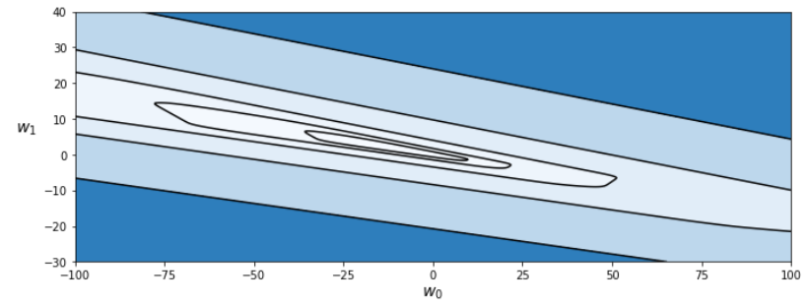

Slide 9
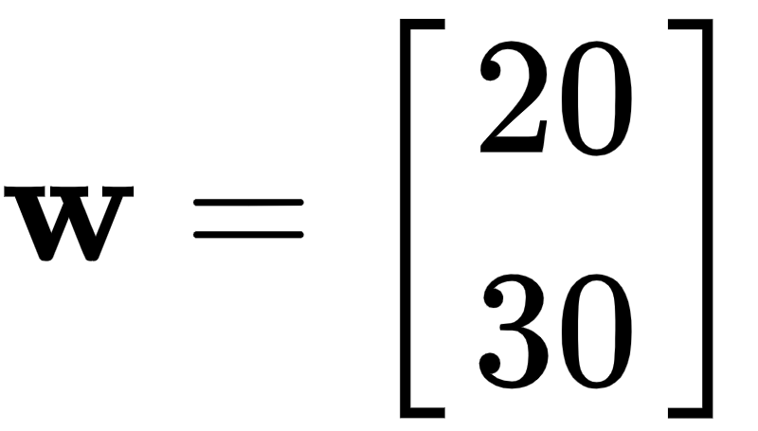
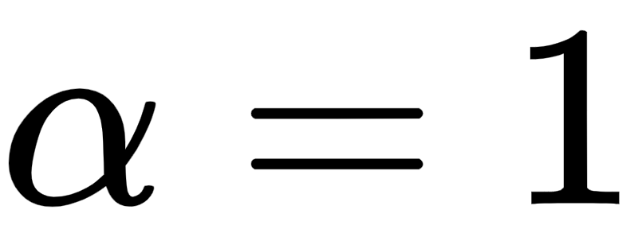
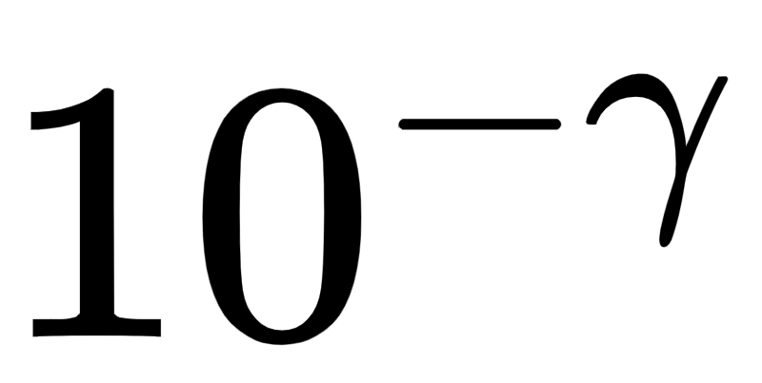
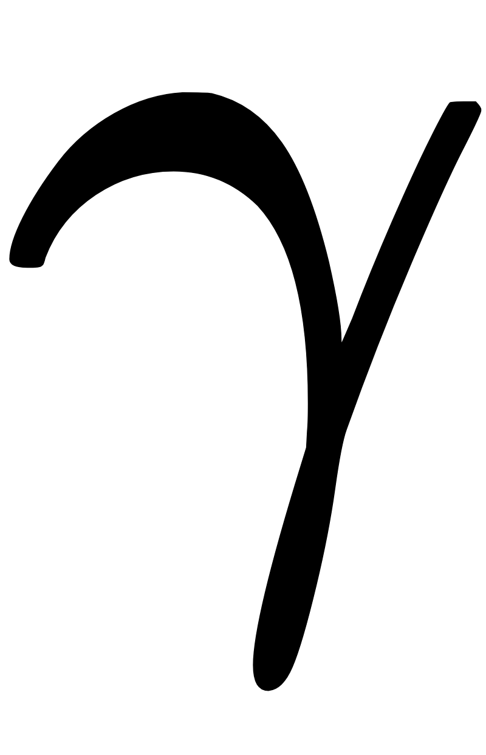
We can confirm this intuition by making a run of gradient descent - which we do below.
Beginning at the point we visualize 100 steps of gradient descent with a fixed steplength .
This was the largest steplength size of the form with an integer that we found that did not cause gradient descent to diverge here.
Here the steps are colored from green to red as gradient descent begins (green) to when it ends (red).

Slide 10
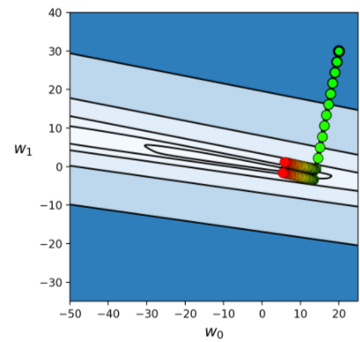

Slide 11
We can see that we still have a long way to travel to reach the minimum of the cost function, and that these steps will continue to zig-zag considerably.

Slide 12
Below we plot the logistic sigmoid (in red) given by the final set of weights learned in this run of gradient descent.
Precisely those associated with the final red point plotted on the contour plot above.
And since these weights lie so far from the minimum we learn a poor classifier here.

Slide 13
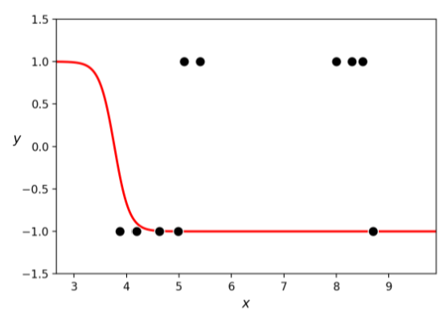

Slide 14
Standard normalization provides precisely the same benefit we saw above for any learning problem, in particular two class linear classification.
As with regression, this simple normalization 'trick' has a profound impact on the shape of our cost function.
As with regression, it tends to "round out" the contours of the cost, making it much easier to minimize properly.

Slide 15
Lets now examine the contours of the softmax cost function using the normalized input.
As we can see below, the contours of this cost function are drastically improved.

Slide 16
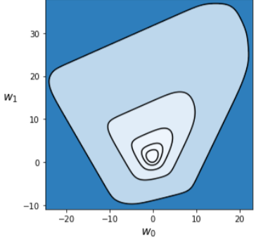

Slide 17
Below we animate the transformation from original to standard normalized contours.
You can really get a sense of just how much standard normalization (of the input data) warps the original cost, making it far easier to work with.

Slide 18
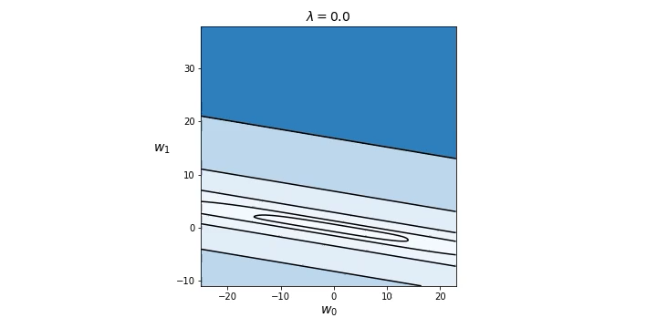

Slide 19
Now we make a run of gradient descent to find an approximate global minimum of this softmax cost.
We will initialize at precisely the same point as was done previously.

Slide 20
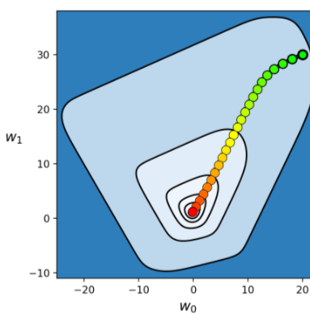

Slide 21
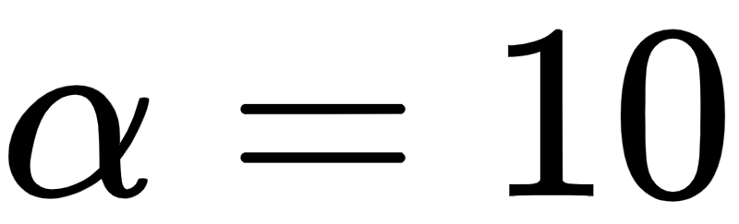
Here we used the largest steplength of the form possible, which in this instance is
Whenever we normalize input like this we can virtually always use a larger fixed steplength value.
Here - however - we will only use 25 steps (one-fourth as many as we ran above in minimizing the softmax with un-normalized data).
Nonetheless even with so few steps - as can be seen below - we easily minimize the softmax cost and find an approximate global global minimum.

Slide 22
In other words, after standard normalization we can use a much larger steplength and in far fewer steps we get much closer to the cost function minimum!
Let us plot the logistic cost associated with the final set of weights (the final red point above) with the original dataset.
The final logistic predictor is far superior to the one we found previously, where we took 4 times as many gradient descent steps, prior to normalizing the input data.

Slide 23
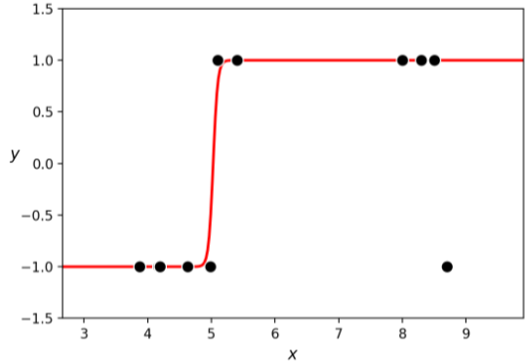

Slide 24

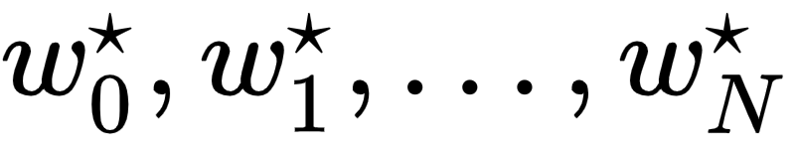
As with linear regression, when dealing with N dimensional input datasets we normalize each input feature precisely as we shown above with regression.
Note to evaluate any new test point - using our fully tuned parameters, we have to treat it as we did our training data.

Slide 25
That is we normalize each input feature using the same statistics we computed on the training data above as

Slide 26
Summary and discussion

Slide 27
The empirical findings described in this Section are indicative of the more general utility of standard normalization in general.
First and foremost, they is indicative of a more general truth regarding machine learning cost functions: normalizing the input features of a dataset by mean centering and scaling by the standard deviation of each input will results in a cost function with less elliptical and more 'circular' contours.
This includes regression, (two-class / multi-class) classification, as well as unsupervised learning cost functions. Below we illustrate this statement graphically.

Slide 28
In the top row we show the input (only) of a prototypical N = 2 dimensional input dataset (top left panel), as well as its mean-centered (top middle panel), and scaled version (top right panel).
Once complete, this invertible transformation results in a centered and more compactly confined version of the data.
Simultaneously - as shown in the bottom row where a prototypical cost function corresponding to this data is shown - standard normalization results in a cost function with much 'nicer' and less elliptical contours.

Slide 29
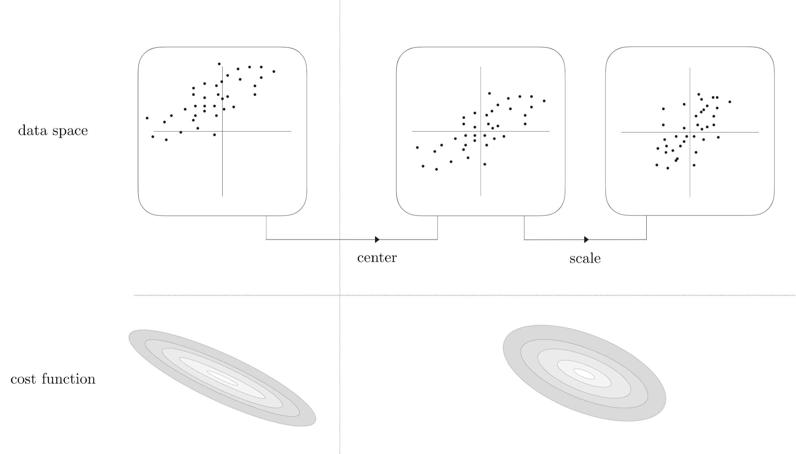

Slide 30
Why is it the case that making the contours of a cost function less 'elliptical' and more 'circular' helps make optimization easier when using a first order optimization method like gradient descent?
Because - as discussed in [Section 3.7] - that the gradient descent direction always points perpendicular to the contours of a cost function.

Slide 31
This means that - when applied to minimize a cost function with elliptical contours like the example shown in the left panel below - that the gradient descent direction (while still a descent direction) points away from the global minimum of the function.
This characteristic naturally leads the gradient descent algorithm to take 'zig-zag' steps back and forth particularly when in 'long narrow valleys' like those present in the long axes of a cost function with elliptical contours.

Slide 32
In normalizing the data we temper such elliptical contours, transforming them into more circular contours as shown in the middle and (ideally) the right panels below.

Slide 33
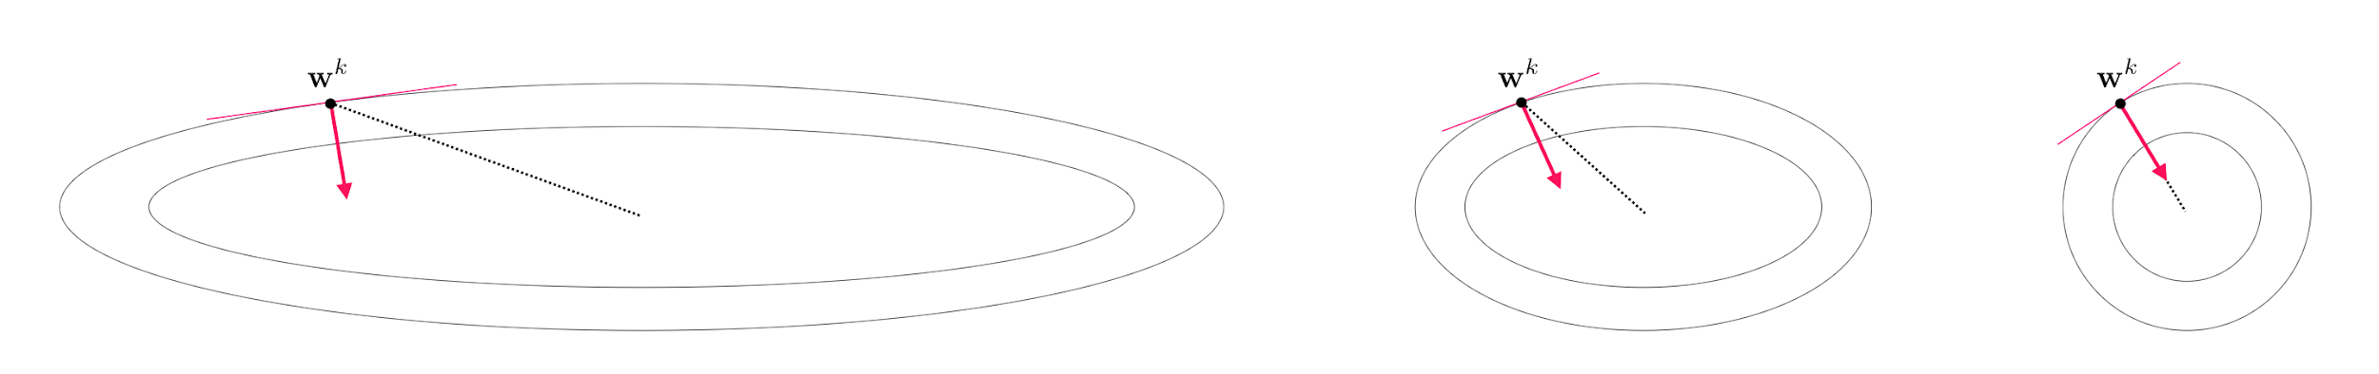

Slide 34
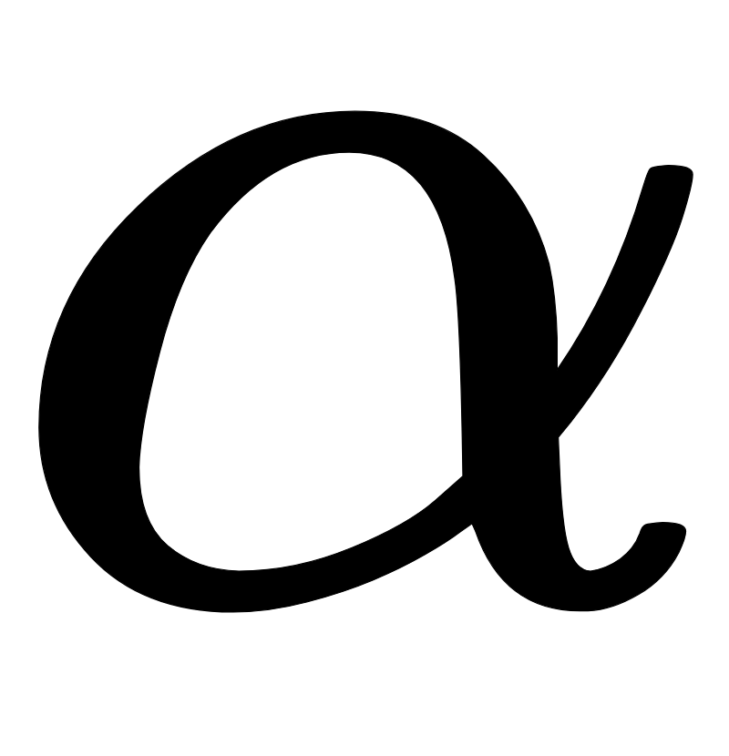
With more circular contours the gradient descent direction starts pointing more in the direction of the cost function minima, making each gradient descent step much more effective.
This also helps explain why we can typically use a much larger steplength parameter when minimizing a cost function of standard normalized data - since the gradient descent direction points in a better direction we can freely travel in it much further at each step.

